Slide 1


Contextualizing Lectures
A Proposal for Bridging the Gap Between Static Slides and Dynamic Professor Insights using Multimodal Study Assistant
Students:
Osama Ahmed Hadi
Nabil Ibrahim Nagi
Emad Ayman Abdullah
Mohamed Essam Abdel Hamid

Slide 2


The Disconnect in Modern Education
Static Summaries: Lecture slides often contain only high-level bullet points, serving as an outline rather than a comprehensive guide.
Dynamic Context: Professors provide massive value verbally—explaining complex mechanics, giving real-world examples, and hinting at exam topics.
The Student Struggle: Students frequently fail to map this crucial, unstructured verbal context back to specific slides while studying later.
The Goal: Empower students to easily bridge the gap between lecture slides and the professor's transcript, capturing every "hidden note" seamlessly.

Slide 3








The Proposed Solution Architecture
Audio Extraction
Slide Parsing
AI Alignment
Isolate audio from provided lecture videos and run local transcription (e.g., Whisper) to generate highly accurate, time-stamped textual data.
Programmatically parse the PDF lecture slides to extract text arrays, metadata, and concepts, indexing them securely by specific page numbers.
Utilize an LLM to analyze the transcript against the parsed slides, mapping spoken concepts to written bullet points to extract unseen context.

Slide 4
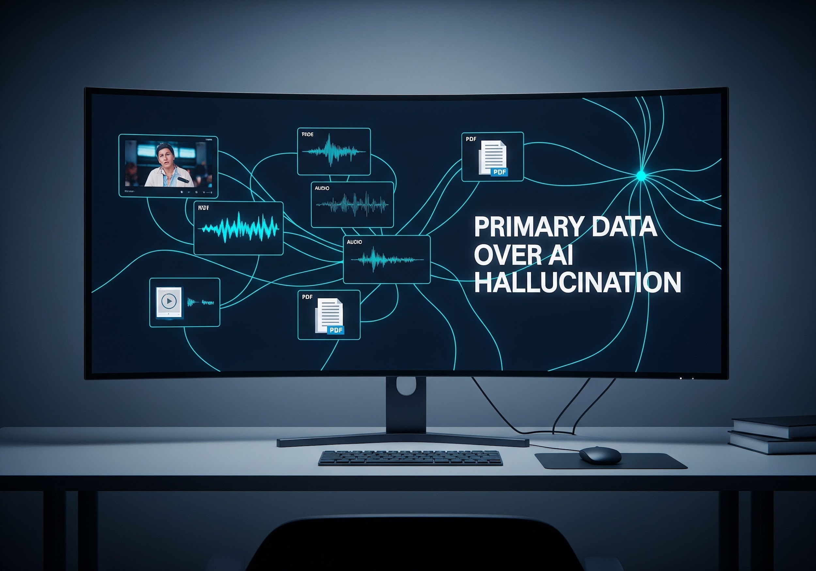


Clarifying Our Scope & Non-Goals
Not Generative Content
We are not creating information from the AI's internal knowledge. Every insight is anchored directly in the provided lecture video, audio transcript, or slides.
Not Just a Summary
Our goal is not to shorten the material, but to contextualize it—mapping verbal explanations back to static slide points to provide a unified primary resource.

Slide 5

Extracting the "Hidden Notes"
Intelligent Prompting
The true innovation lies in going beyond basic summarization. We are mining the video for unique insights.
Identifying the Gap
The AI hunts for info that is verbally spoken but distinctly absent from the slide text.
Instructor Cues
Capturing high-priority cues like "this is important" or exam hints as student annotations.

Slide 6





Core Library Stack
OpenAI API Wrapper
PyMuPDF
Streamlit
A highly resilient, multi-threaded client used to interface with Gemini Flash. It handles rate-limiting, exponential backoffs, and ensures reliable communication with the AI models.
The primary tool for programmatic PDF parsing. It extracts raw text and metadata from lecture slides, allowing for precise indexing by page number for the AI alignment process.
The framework for building the side-by-side user interface. It renders the original PDF slides alongside AI-generated notes and supports interactive chat and search features.

Slide 7

Proposed Tech Stack (100% Free)
Component | Technology Choice | Cost | Primary Purpose
Core Logic | Python 3.10+ | $0.00 | Backbone orchestration and file handling.
Transcription | OpenAI Whisper (Local) | $0.00 | Offline generation of timestamped audio text.
PDF Parsing | PyMuPDF (fitz) | $0.00 | Extracting raw text mapped to specific slide numbers.
AI Brain | Gemini 2.5/3.0 Flash API | $0.00 | Contextual alignment and "Hidden Note" extraction.
User Interface | Streamlit | $0.00 | Rendering side-by-side view of PDFs and AI Notes.

Slide 8

Proposed: Visual-Aware Transcription
The "Snapshot" Approach
Alternative Approach
A proposed alternative to audio-only transcription that we might implement to leverage the full visual context of the lecture.
timer Temporal Sampling: Video snapshots every 5-10 seconds capture whiteboards and non-verbal cues.
Structural Splitting: Gemini API syncs frames with audio to auto-segment the transcript logically.
psychology Detailed Feed: Creates a rich dataset specifically optimized for downstream "AI Brain" processing.

Slide 9
Navigating Constraints
Strategies for operating successfully within Google AI Studio's Free Tier limitations.

Slide 10


API Limit Management
The Bottleneck
The Batching Solution
As of May 2026, the Google AI Studio Free Tier strictly throttles Gemini 2.5 Flash and Gemini 3 Flash to 20 Requests Per Day (RPD).
Passing a full 1-hour lecture transcript and slide deck in a single request or rapid bursts will result in API failure.
The Python pipeline will implement strict temporal chunking, passing transcripts in 3 to 5-minute logical blocks.
A programmed time.sleep() delay between requests ensures safe processing.
Enables entire lecture processing at zero cost without triggering rate limits.

Slide 11


Non-Linear Content Alignment
The Asynchrony Challenge
Contextual Re-Mapping
Professors often deviate from a 1-to-1 slide sequence, incorporating external materials, deep-dives, or non-linear explanations.
A simple chronological mapping results in contextual mismatch between the video transcript and the static slide deck.
Our system uses smart search to find the best slide for every part of the talk, even if the professor jumps around.
We could operating modes to fit different needs:
1-to-1 Match: Traditional direct slide sequence.
Additional Information: Links extra content to core concepts.
This makes sure the notes always stay organized, no matter how the lesson is delivered.

Slide 12


Proposed Workflow
Chunking & Batching
MP4 Video
PDF Slides
Audio Extraction
PyMuPDF Extract
Gemini Flash API
Rate Limit Control
Local Whisper/Gemini API
Slide Text Array
Data Assembly
FINAL OUTPUT JSON
Timestamped JSON

Slide 13

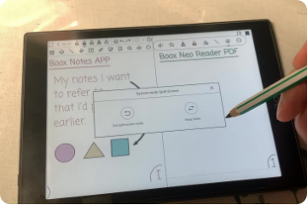

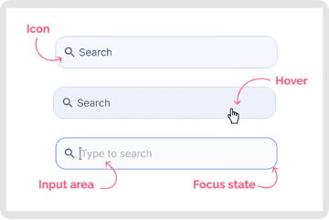

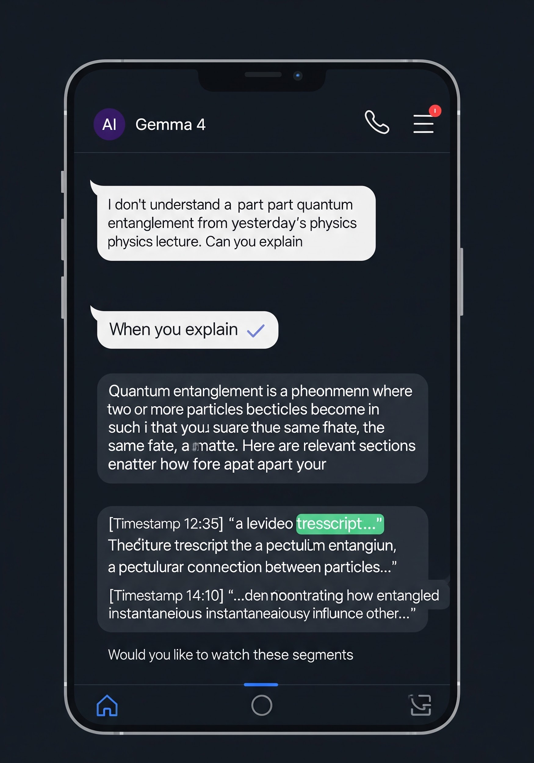
Future Expansions (UI/UX)
Side-by-Side UI
Smart Search
Contextual Chat
A planned Streamlit interface combining the original PDF and extracted contextual notes.
Allowing students to query the exact timestamp where a professor mentioned a specific keyword.
Chat about the lecture with small and faster model like Gemma 4, leveraging the full video transcript and overall context for fast, precise answers.

Slide 14
Proposal Review
Thank you for your time. I am open to feedback and suggestions.
Ready to commence development upon approval.

